Slide 1

Department of Artificial Intelligence and Data Science
XAI DEEP LEARNING FRAMEWORK FOR INTELLIGENT NETWORK INTRUSION DETECTION
Ms.Ponnila P
Assistant Prof.
Dept AI & DS
DEVIKA C (221801009)
KEERTHIKA P (221801027)
LAVANYA S (221801028)

Slide 2
Problem Statement and Motivation
PROBLEM STATEMENT:
  Ineffective & Heavy Systems: Current tools struggle with growing traffic and new attack methods.
  Undetected Threats: Many threats, especially unknown ones, bypass existing solutions.
  Need for Smart Detection: Requires lightweight, real-time monitoring with clear alerts and reports.
MOTIVATION:
  Smart & Real-Time Detection: Monitors network traffic and identifies evolving cyberattacks efficiently.
  Accessible & Practical: Provides clear alerts without requiring expensive hardware.

Slide 3
EXISTING SYSTEM
Signature-based Systems
Anomaly-based Systems
Hybrid Systems
Machine Learning-based Systems
Deep Learning-based Systems

Slide 4
Objective
General Objective:
  Develop a lightweight, real-time, and intelligent Network Intrusion Detection System (NIDS) for accurate detection, automated response, and adaptability.
Specific Objectives:
  Accurate Real-time Intrusion Detection
  Minimize False Positives
  High Detection Accuracy
  Scalability and Adaptability
  Cost-effective Deployment

Slide 5
Abstract
Digital transformation in the travel industry has increased the need for accurate and personalized destination recommendations. Traditional methods struggle with limited user data and repetitive suggestions, reducing their effectiveness. A combined approach that uses both user behavior patterns and destination features helps overcome these gaps, ensuring meaningful results even for new users. By leveraging attributes such as climate, activities, and location, the system generates strong initial suggestions. As user interactions grow, preference patterns further refine the accuracy of recommendations. This balance of relevance and novelty encourages users to explore new places while still matching their interests. The approach improves user satisfaction, supports better travel planning decisions, and enhances the overall user experience. Its adaptable design also shows potential for use in other fields such as e-commerce and entertainment, where personalization is essential. Overall, the model contributes to more dynamic, engaging, and intelligent recommendation systems.

Slide 6
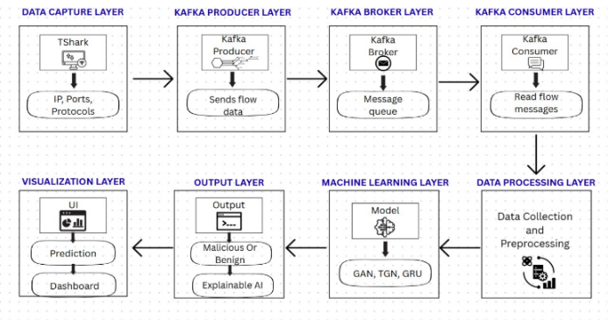
Architecture(framework)

Slide 7
MODULE
Data Collections and Data Preprocessing.
Kafka and T-shark.
Dynamic Fusion of Graphs.
LLM Integration.
Web Interface.

Slide 8
Conclusion
AI-powered framework for real-time network intrusion detection, integrating Kafka with GAN, TGN, and GRU models. Detects known and emerging threats with high accuracy and provides explainable results. Real-time dashboard enables proactive decision-making and improved security awareness. Enhances scalability, latency, and threat detection in modern networks.

Slide 9
Thank You

